Slide 1

WaveSense
Temporal processing with feed-forward
spiking neural networks
Philipp Weidel,
Neuromorphic R&D Engineer, SynSense AG

Slide 2
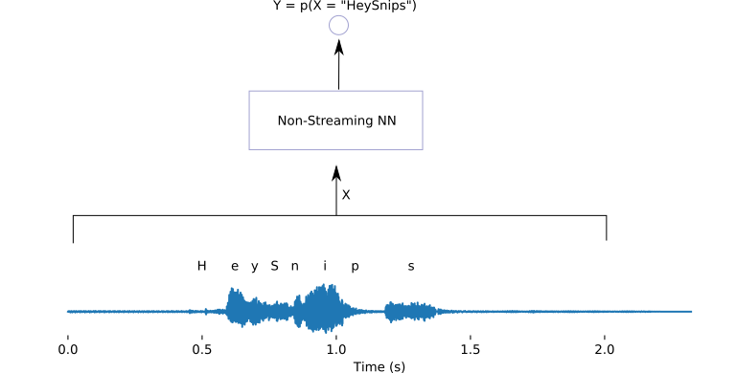
Streaming vs Non-sreaming Models
Temporal dependency
Information from the past is needed
Longest temporal dependency determines the amount of memory needed in the system
Two kinds of models:
Non-Streaming
Streaming

Slide 3
Non-sreaming Models
Non-streaming models
DNN
CNN
Attention
WaveNet
Pros:
Easy to Train
Good performance
Cons:
Need to buffer input data
Large latency

Slide 4
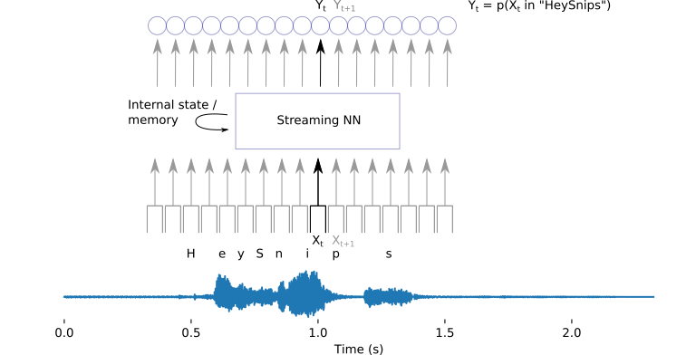
Streaming Models
Streaming models:
RNN
LSTM
GRU
SnipsNet
SNN
Pros:
Buffer much less data
Cons:
Harder to train
Internal state needed
Models can be converted to be streaming

Slide 5

WaveNet (Deepmind)
Causal and dilated CNN
Causal
Only connections to the past
Dilated
Sparse kernel
Easy to transform to streaming model
Source: https://deepmind.com/blog/article/wavenet-generative-model-raw-audio

Slide 6
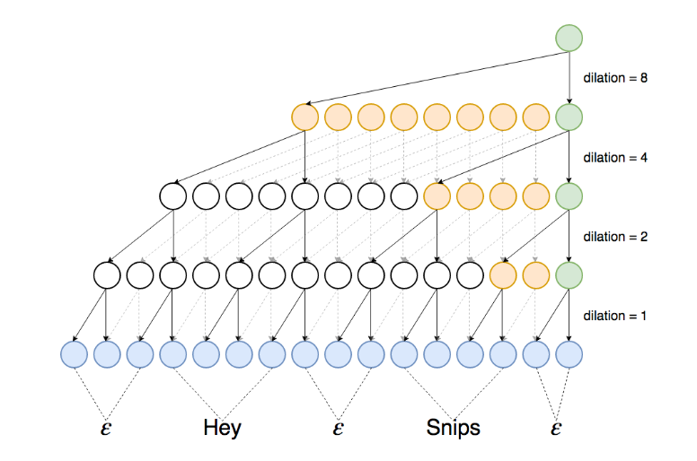
SnipsNet
Each layer doubles the memory
Computationally efficient
Only compute green nodes
Memory efficient
Buffer orange nodes
Can we translate this model to SNN?
Source:
Coucke et al. 2019

Slide 7
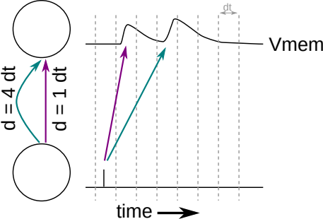
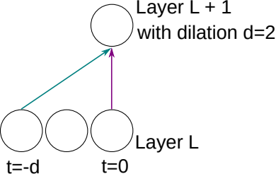
Focus on the computational units
Delayed connection
Buffer activations for d timesteps
Can we get rid of the buffers / delays?
$Y^{L}\left(t\right)=Θ\left(Y^{L−1}\left(t−d\right)+Y^{L−1}\left(t\right)\right)$

Slide 8
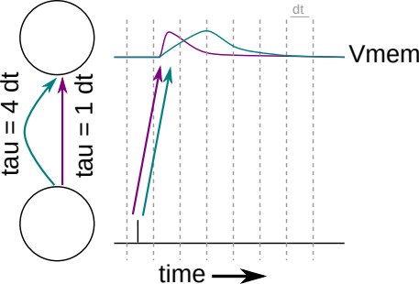
Internal states as temporal memory
SNNs: Input spikes evoke deflection of membrane potential over a duration of time (EPSP)
Depends on membrane and synaptic time-constants

Slide 9
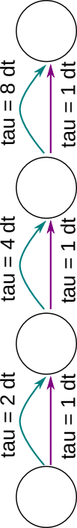
SnipsNet and WaveSense
SnipsNet
WaveSense

Slide 10
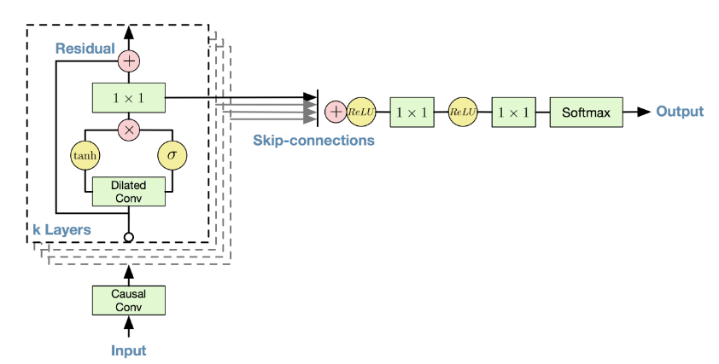
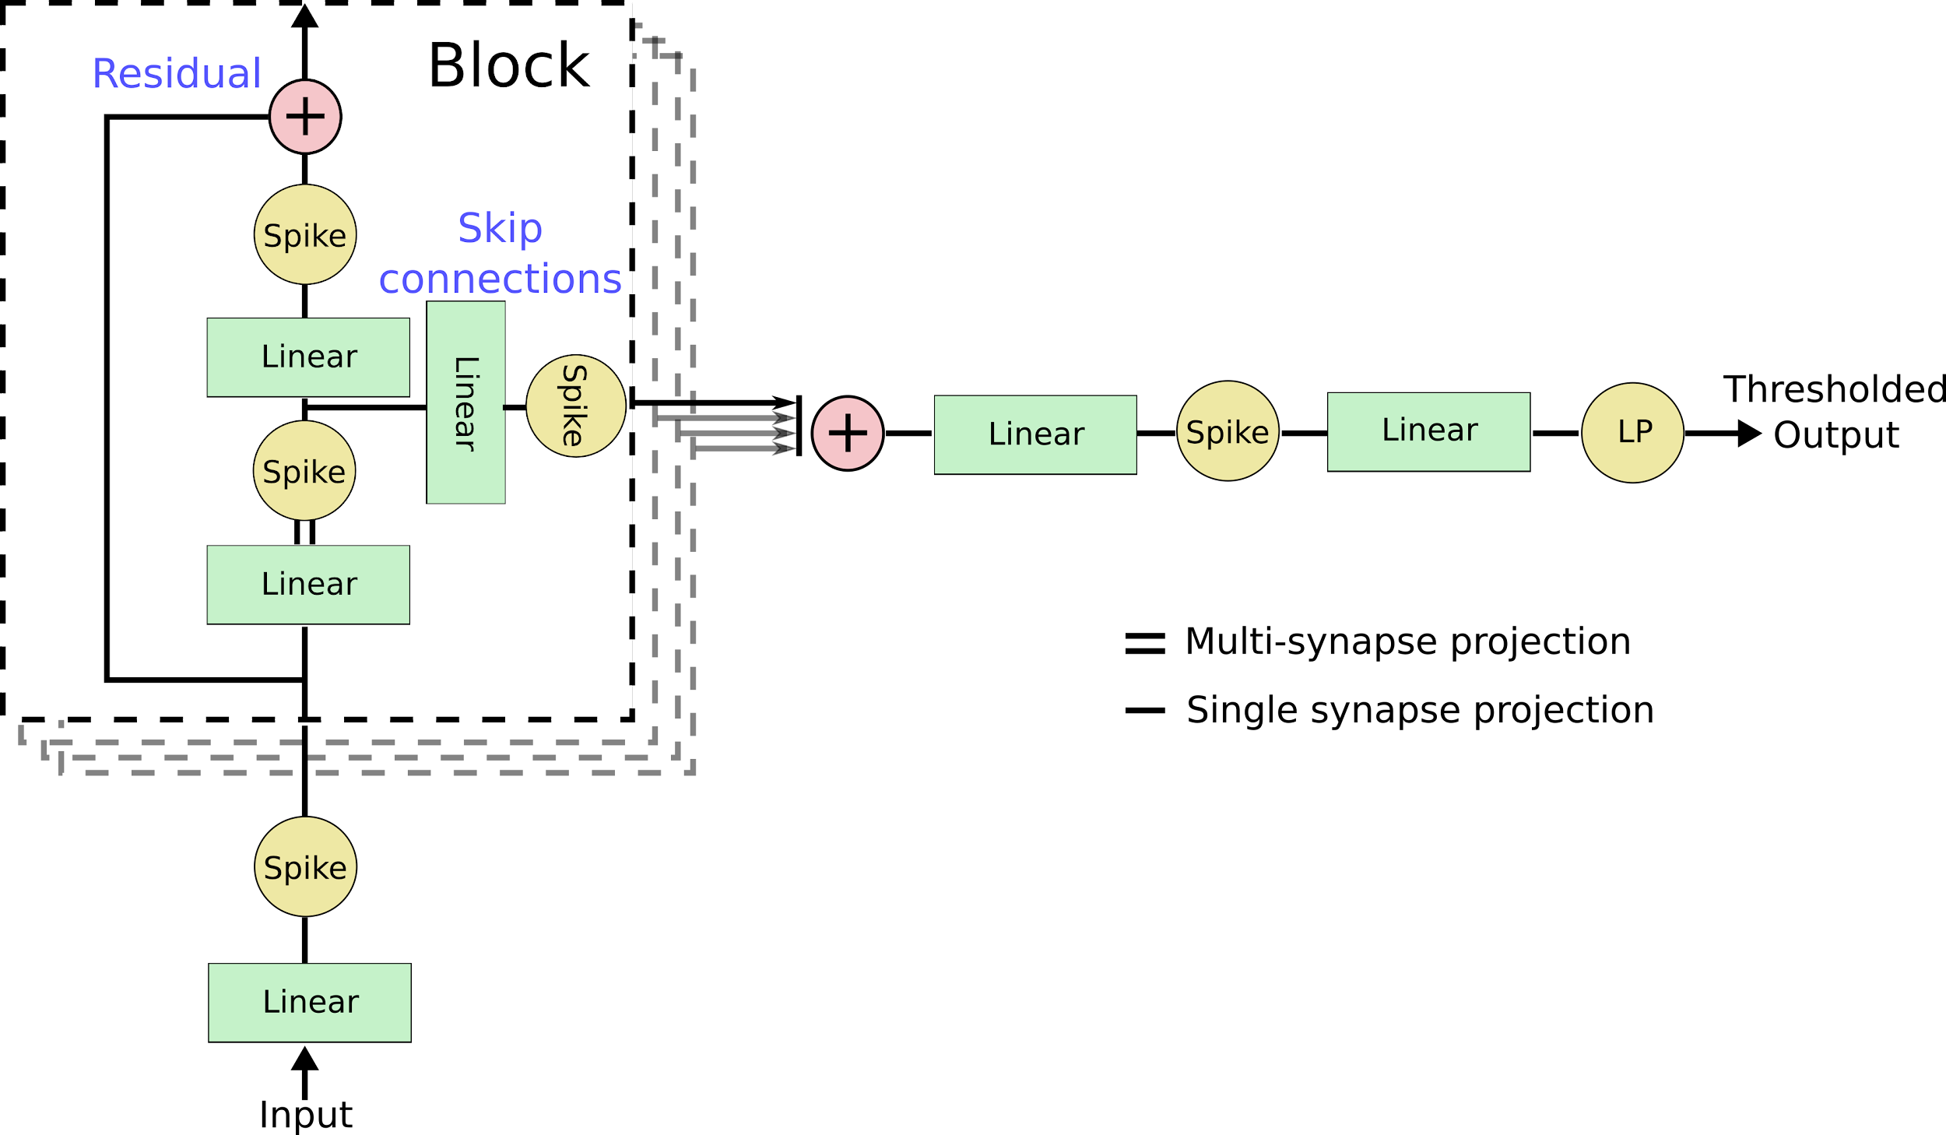
Complete Network
WaveSense
SnipsNet

Slide 11
Results
 | HeySnips | Aloha | Speechcommands(35)
Coucke et al (SnipsNet) | FAPH: 0.5 FRR: 0.12 (0.98)% ACC: ?
Coucke et al (LSTM) | FAPH: 0.5 FRR: 2.09% ACC: ?
Coucke et al (CNN) | FAPH: 0.5 FRR: 2.51% ACC ?
Blouw et al (SNN) |  | ACC: 95.8%
Cramer et al (LSTM) |  |  | ACC: 73.0 +- 0.1%
Cramer et al (CNN) |  |  | ACC: 77.7 +- 0.2%
Cramer et al (SNN) |  |  | ACC: 50.9 +- 1.1%
Ours (WaveNet (ANN)) | 99.8% ACC (FRR 0.8 FAPH 0.95) | ACC: 99.5% | ACC: 87.6%
Ours (WaveSense (SNN)) | 99.6% ACC (FRR 1.0 FAPH 1.34) | ACC: 98.4% | ACC: 79.6%

Slide 12
Click here to add a title
Click here to add a subtitle
Click here to add content

Slide 13
Click here to add a title
Click here to add a subtitle
Click here to add content

Slide 14
Click here to add a title
Click here to add a subtitle
Click here to add content

Slide 15


Thank you ！
Make Intelligence Smarter
Contact us
QiaoNing
Founder and CEO
000 0000 0000
Follow Us

Slide 16
Catalogue
Part I contents
Part f II Contents
Part III contents

Slide 17
Catalogue
Part I contents
Part f II Contents
Part III contents

Slide 18
Click here to add a title
Click here to add a subtitle
Click here to add content

Slide 19
Click here to add a title
Click here to add a subtitle
Click here to add content

Slide 20
Click here to add a title
Click here to add a subtitle
Click here to add content

Slide 21
Click here to add a title
Click here to add a subtitle
Click here to add content

Slide 22
Thank you ！
Make Intelligence Smarter
Contact us
QiaoNing
Founder and CEO
000 0000 0000
Follow Us

Slide 23
Content typesetting demonstration and description

Slide 24







Click here to add a title
Your title 04
Maecenas porttitor congue massa. Fusce posuere, magna sed pulvinar ultricies, purus lectus malesuada libero, sit amet commodo magna eros quis urna.
Your title 02
Your title 03
Fusce posuere, magna sed pulvinar ultricies, purus
lectus malesuada libero, sit amet commodo magna eros
Maecenas porttitor congue massa. Fusce posuere, magna sed pulvinar ultricies, purus lectus malesuada libero, sit amet commodo magna eros quis urna.
.
Your title 01
Maecenas porttitor congue massa. Fusce posuere, magna sed pulvinar ultricies, purus lectus malesuada libero, sit amet commodo magna eros quis urna.

Slide 25
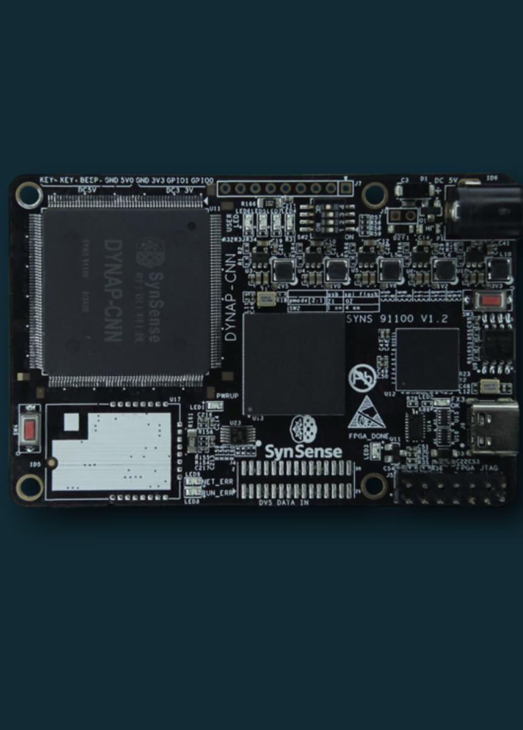
Click here to add a title
01
Samna
02
Rockpool
03
Sinabs
Samna is a developer interface tool (upper computer) designed for the company's chip product tool chain and real-time interaction environment.
Its core is written in C++ language and provides Python API and data visualization tools externally.
With Samna, users can easily configure the pulsed neural network inside the company's on-board brain-like chip and process event-based data streams in real time.
Samna is compatible with Rockpool and Sinabs, and supports configuration of pulsed-neural networks generated by these two
Samna is compatible with Rockpool and Sinabs, and supports configuration of pulsed-neural networks generated by these two pulsed-neural network simulation and development frameworks onto the company's chips.
DYNAP ™ - CNN development board
Reference: Indiveri, G., Corradi, F., Qiao, N. “Neuromorphic architectures for spiking deep neural networks. In Electron Devices Meeting (2015).

Slide 26




Click here to add a title
Title here
Title here
Title here
Title here
Your title
Pellentesque habitant morbi tristique senectus et netus et malesuada fames ac turpis egestas.
Year 1
Year 2
Year 3
Year 4
100
Your title
Pellentesque habitant morbi tristique senectus et netus et malesuada fames ac turpis egestas.
80
60
Your title
Pellentesque habitant morbi tristique senectus et netus et malesuada fames ac turpis egestas.
40
20
Your title
Pellentesque habitant morbi tristique senectus et netus et malesuada fames ac turpis egestas.
0

Slide 27

Click here to add a title
At vero eos et accusamus et iusto odio dignissimos ducimus qui blanditiis praesentium voluptatum
At vero eos et accusamus et iusto odio dignissimos ducimus qui blanditiis praesentium voluptatum
At vero eos et accusamus et iusto odio dignissimos ducimus qui blanditiis praesentium voluptatum
Sed ut perspiciatis
unde omnis
Sed ut perspiciatis
unde omnis
Sed ut perspiciatis
unde omnis
Sed ut perspiciatis
unde omnis
Sed ut perspiciatis
unde omnis
At vero eos et accusamus et iusto odio dignissimos ducimus qui blanditiis praesentium voluptatum
At vero eos et accusamus et iusto odio dignissimos ducimus qui blanditiis praesentium voluptatum

Slide 28
Specification of text and color in ppt
ppt cover
Main title text font -Arial Bold
Main title text size -60
Subtitle text font -Arial Regular
Subtitle text size -17
ppt catalogue
Main title text font -Arial Bold
Main title text size -36
Subtitle text font -Arial Regular
Subtitle text size -20
ppt Inner page
First level title text font -Arial Regular
First level title text size -36
Secondary title text size -Arial Regular
Secondary title text size -20
Three level title text size -Arial Regular
Three level title text size -16
ppt back cover
First level title text font -Arial Bold
First level title text size -66
Secondary title text size -Arial Regular
Secondary title text size -20
Three level title text size -Arial Regular
Three level title text size -16
Level IV title text size -Arial Bold
Level IV title text size -14
Text font -Arial Bold
Text font size -12
R：0 G：75 B：103
R：0 G：177 B：240
R：146 G：208 B：80
R：0 G：201 B：210
R：255 G：147 B：0

